Slide 1
Optimization of Outpatient Clinic Processes through simulation
Mownika Konamaneni
Prathyusha bhuma
Siri kesidi

Slide 2
introduction
OBJECTIVES:
Understand challenges faced by outpatient clinics.
Explore simulation modeling for process improvement.
CHALLENGES:
Long wait times
Resource underutilization
Inefficient workflows
ROLE OF SIMULATION:
Analyzing current clinic processes
Identifying bottlenecks
Testing improvements.

Slide 3
Clinic Process Overview
Patient Registration: Patients enter the clinic and register with the patient registrar.
Examination Waiting Area: Returning patients proceed directly to the exam waiting area, while new patients are given additional paperwork.
Nurse Interview: Once available, the nurse conducts a preliminary interview with the patient.
MD Examination: Patients are examined by the MD to assess their medical condition.
EKG/Lab (if required): Some patients may require additional tests such as EKG or Lab work, which are conducted by the nurse.
Finance Desk: Patients stop by the finance desk for any necessary payments and to schedule follow-up appointments.
Clinic Staff:
1 receptionist (registration)
1 bookkeeper (finance)
1 nurse
1 MD on a typical day.

Slide 4
Simulation Parameters
Data Element | Process Time | Probability/Distribution
Patient Interarrival Time | 5 minutes | Exponential (5)
Registration | 6 minutes | Lognormal (6, 1.25)
New Patient Percentage | -- | 32%
New Patient Paperwork | 5 minutes | Lognormal (5, 2.5)
Nurse Interview | 10 minutes | Lognormal (10, 3.75)
MD Exam | 20 minutes | Triangular (10, 20, 35)
EKG/Lab Percentage | -- | 25%
EKG/Lab | 22 minutes | Triangular (10, 22, 35)
Check out | 2 minutes | Lognormal (2, 0.5)
Clinic is open from 9:00 am to 5:00 pm and run the model for one day

Slide 5
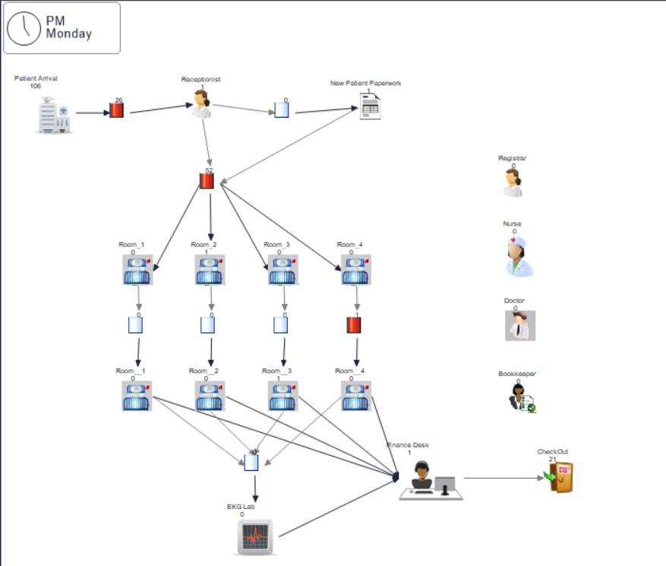
Phase I: Model Development
We focused on developing the initial simulation model to capture the overall clinic process.
Components of Phase I Model:
Process Flow Chart: Visual representation of the sequential steps involved in the clinic process.
Resource Allocation: Allocation of staff resources including receptionists, nurses, MDs, and bookkeepers.
Queue Management: Management of patient queues at different stages to analyze waiting times.

Slide 6
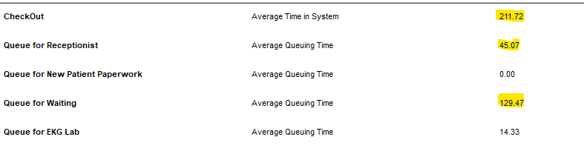
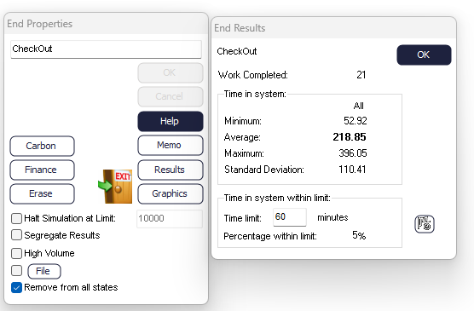
Phase I: Results
Expected time a patient must wait before the examination begins
Queue for Receptionist + Queue for New Patient Paperwork + Queue for Waiting = 45.07 + 0.00 + 129.47 = 174.54 minutes = 2.909 hrs
Average time a patient will spend in the clinic
211.72 minutes = 3.52 hrs
5 percentages of patients complete their visit in 1 hour or less
The clinic’s staffing is not sufficient as seen by running the model.

Slide 7
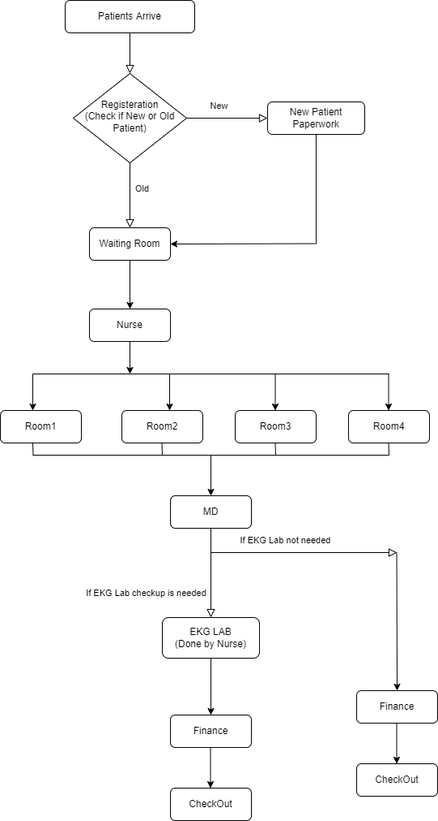
Phase II - Flowchart Visualization

Slide 8
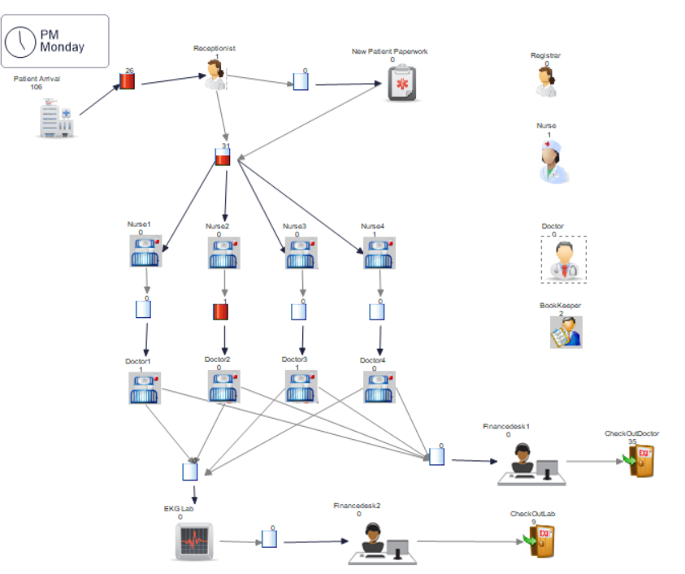
Phase Ii: additional resources and financial analysis
In this phase we focused on refining the simulation model to incorporate additional complexities and scenarios.
Incorporation of Multiple Checkout Options: The model was enhanced to include various checkout options, reflecting real-world clinic operations more accurately.
Allocation of Additional Resources: Additional resources, including Doctors, Nurses and bookkeepers were allocated to meet increased demand and improve service capacity.
Introduction of Shift Allocation: Shifts were allocated to staff members to ensure continuous coverage and efficient utilization of resources throughout the day.
Inclusion of Financial Metrics: Daily costs, revenue generation, and profit calculations were integrated into the model to assess the financial impact of operational changes and resource allocation.

Slide 9
PHASE ii – additional resources and financial aspects
Position | Daily Cost | Revenue
Registrar | $200
Nurse | $500
MD | $2000
Bookkeeper(check-out) | $150
Doctor Charge |  | $250
XRAY/EKG/Lab Charge |  | $400
Position | Staff
Registrar | 2
Nurses | 2
MDs | 4
Bookkeeper | 1

Slide 10
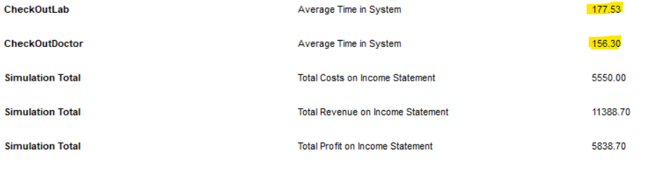
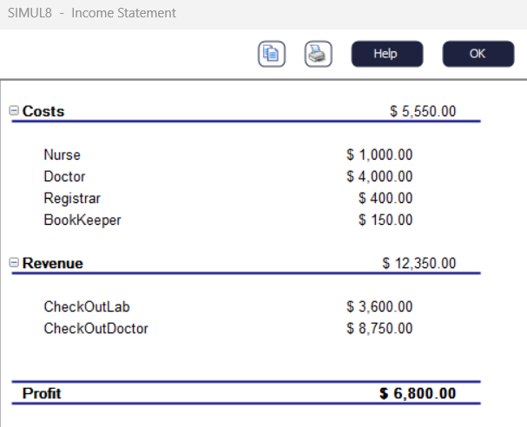
Phase Ii: Results
Average time a patient will spend in the clinic
177.53 minutes = 2.95 hrs (who need lab work)
156.30 minutes = 2.605 hrs (Only visits doctor)
The profit made at the end of the day is $6,800.

Slide 11
Conclusion
The Phase II model represents an improved version of Phase I, incorporating additional complexities and scenarios to better replicate real-world clinic operations.
Through model refinements, patient wait times have been significantly reduced, enhancing overall clinic efficiency and patient satisfaction.
Financial analysis has revealed insights into revenue generation, cost management, and profit optimization, guiding strategic decision-making.
The allocation of additional resources, such as staff and shifts, has proven instrumental in meeting increased demand and improving service capacity.

Slide 12
Future Improvements
Scheduling
Appointment Scheduling: Implementing a system for scheduling patient appointments could help regulate patient flow and reduce wait times by ensuring a more even distribution of appointments throughout the day.
Limiting
Limiting New Patient Intake: Setting a cap on the number of new patients accepted per day could help manage clinic capacity more effectively, ensuring that resources are optimally allocated and wait times are minimized.

Slide 13
References
Taj, S. and Mousavidin, E. (2015) ‘Using discrete event visual simulation to teach process modelling in MBA operations management courses’, Int. J. Simulation and Process Modelling, Vol. 10, No. 1

Slide 14
Q & A

Slide 15
Thank you
Mownika Konamaneni (mkonamaneni4501@floridapoly.edu)
Prathyusha bhuma (pbhuma7210@floridapoly.edu)
Siri kesidi (ksiri7091@floridapoly.edu)

